Slide 1
Femicide in the World
Global Statistics
Ann N Waiganjo
31/10/2024

Slide 2
Contents
Defining Femicide
Types of femicide
Statistics
Causes
Prevention and Intervention

Slide 3
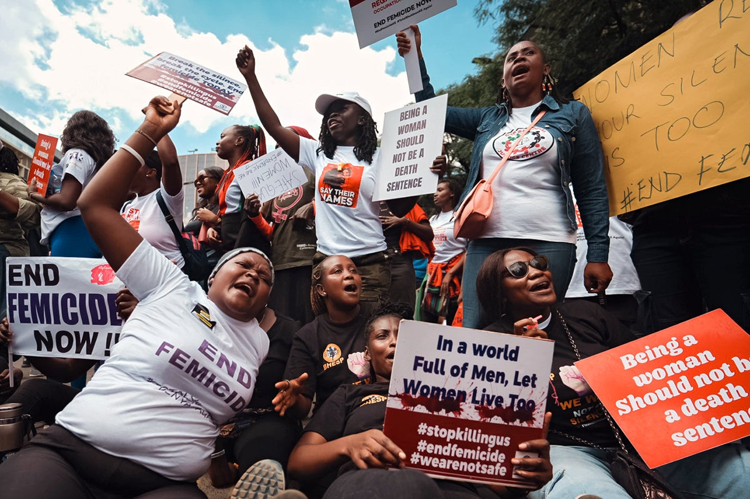
Definition of Femicide
Femicide is a word that was derived from the word “FEMICIDIO” by the Latin Americans, to describe the murder of women because of their gender.
So femicide can be simply described as the act of killing women and girls by men on account of their gender.
In the recent years, media reports have shown a concerning rise in cases of women being killed worldwide.

Slide 4
Types of Femicide
Intimate Partner Violence: Killings by current or former partners.
Honor Killings: Murders justified by a perceived threat to family honor.
Sexual Violence: Murders linked to sexual assault or exploitation
Human Trafficking: Killings resulting from trafficking networks.

Slide 5
In every 1000 femicides
It is estimated that in every 1000 femicides
worldwide, 55% of them is by an intimate
partner or an ex-partner. That totals up to
more than half of the total cases reported.

Slide 6

General Statistics
Every single day, 137 women and girls are killed around the world.
Every 8 hours a woman is killed in South Africa.
400-500 femicides happen every year in Iran.
Everyday, 3 women are killed across the US by either a current or previous intimate partner.
In India, dowry related femicides are the highest with an estimated 20 cases each day.
Kenya has reported 97 cases of femicide in the past 3 months.

Slide 7
Global Statistics Since 2018

Slide 8
2020 Global Statistics

Slide 9
Causes of Femicide
Toxic Masculinity and Gender Inequality - Gender inequality results in power imbalances, with men asserting control and dominance over women, sometimes violently.
Domestic and Intimate Partner Violence - Intimate partner violence (IPV) is a leading cause of femicide. Many femicides occur when a woman tries to leave or refuses to continue a relationship, resulting in violence from partners who feel entitled to have control over them.
Cultural Beliefs and "Honor" - Some societies consider a woman’s behaviour reflective of the family's honour. If she defies cultural norms (through relationships, marriage choices, dress, etc.), family members may resort to honour killings as a way to "restore" the family’s status.
Economic Dependence and Poverty - Economic dependence on partners or family members can trap women in abusive relationships, increasing their risk of violence and femicide.
Lack of Legal Protections and Accountability - In many countries, femicide laws are either non-existent or poorly enforced, leading to a culture of impunity where perpetrators go unpunished.
When legal systems fail to protect women or prosecute abusers, it sends a message that violence against women is tolerated.

Slide 10
Prevention and Intervention Strategies
Strengthen Legal protections and Enforce Laws - Law enforcement and judiciary members should be trained to recognize signs of gender-based violence and prioritize femicide cases.
Enhance Support Systems for Victims - Accessible shelters can provide safe spaces for women and children fleeing abuse.
Education and Awareness Campaigns - National campaigns can raise awareness about femicide, highlight signs of abuse, and promote resources for victims. Programs and workshops aimed at men and boys can encourage positive masculinity, empathy, and healthy relationship skills.
Empower Women Economically and Socially - Programs that provide job training, microloans, or entrepreneurship support can increase women's independence and reduce their risk of being trapped in abusive relationships.
Improve Data Collection and Research - Many countries lack accurate data on femicide. Collecting detailed information on femicide cases can help in designing targeted interventions and monitoring progress.

Slide 11
Remarks
We must all ensure that we do not contribute towards the normalization of violence against women and girls and instead work together and strive to create an environment where everyone feels safe, respected and protected.

Slide 12
Thank You
Ann N Waiganjo

